Slide 1
Final Project: Analyzing GHG Emissions and its Impact on Air Pollution and Wildfires
By: Justin Mai, Sangmin Lee, Edris Elmi

Slide 2
Introduction:
Intergovernmental Panel on Climate Change Assessments:
1st Assessment Report, 1990; believed that climate change was due largely to natural circumstances, little to do with human influence
4th Assessment Report, 2007; observed that climate change is very likely due to human actions, with evidence of an increase in average temp. And GHG concentrations released by humans
6th Assessment Report, 2023; concluded that climate change is undisputedly caused by human actions and influence.
We want to understand how this impacts our way of life. We do this by analyzing the increase in GHG emissions by humans to factors such as wildfire, AQI, and Air pollution

Slide 3
Introduction:
Target Audience: Washington residents, scientists, policymakers
What they gain from this project
We believe that the first step to developing solutions is to being informed of the impacts
They gain information on the correlation between GHG emissions and worldly factors around them
Areas of potential danger with the increase of GHG emissions
Sector, Location, and Company data of GHG emission rates
Understand where to prioritize.

Slide 4
Data Overview:
WA Total GHG Emissions
Data.wa.gov
Collected by government and federal agencies through sources from their metadata inventory
Data includes very specific information on all GHG emissions
No ethical issues; open to all public use
WA Wildfire
Records on large wildfires
Geo.wa.gov
Sourced by the Washington Geospatial Open Data Portal
Comes from a reliable source
Regularly updated by the Washington State departments
No ethical issues; open to all public use
WA AQI and Gas Levels
Washington AQI and air pollution data
Kaggle.com
Sourced by the U.S. Environmental Protection Agency (EPA)
Reliable source
Updated to present year (2023)
Issues: data is collected from seattle only
No ethical issues; open to all public use

Slide 5
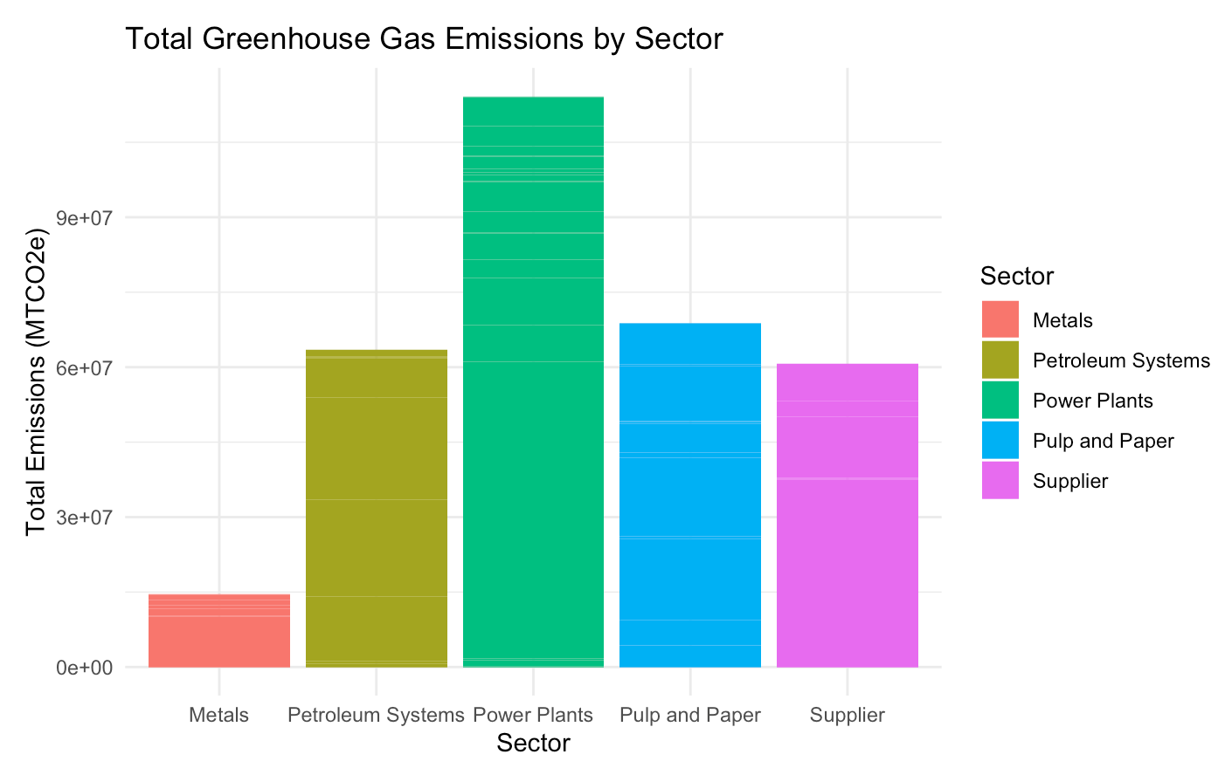
Research Question 1: What are the Total greenhouse gas emissions based on Sector, Location, and Parent Company?
Greenhouse Gas emissions based on Sector

Slide 6
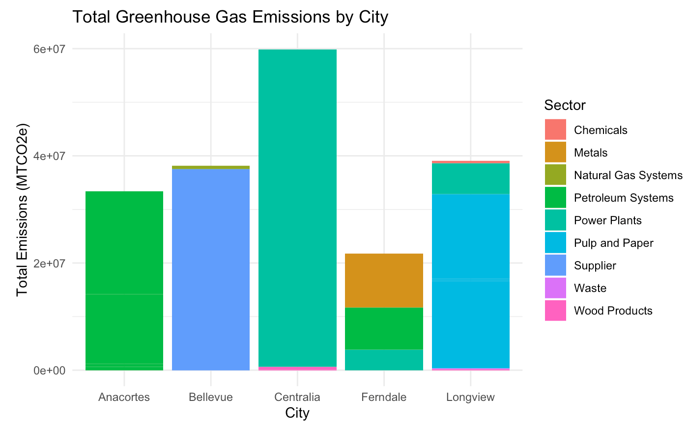
Total greenhouse gas emissions by City

Slide 7
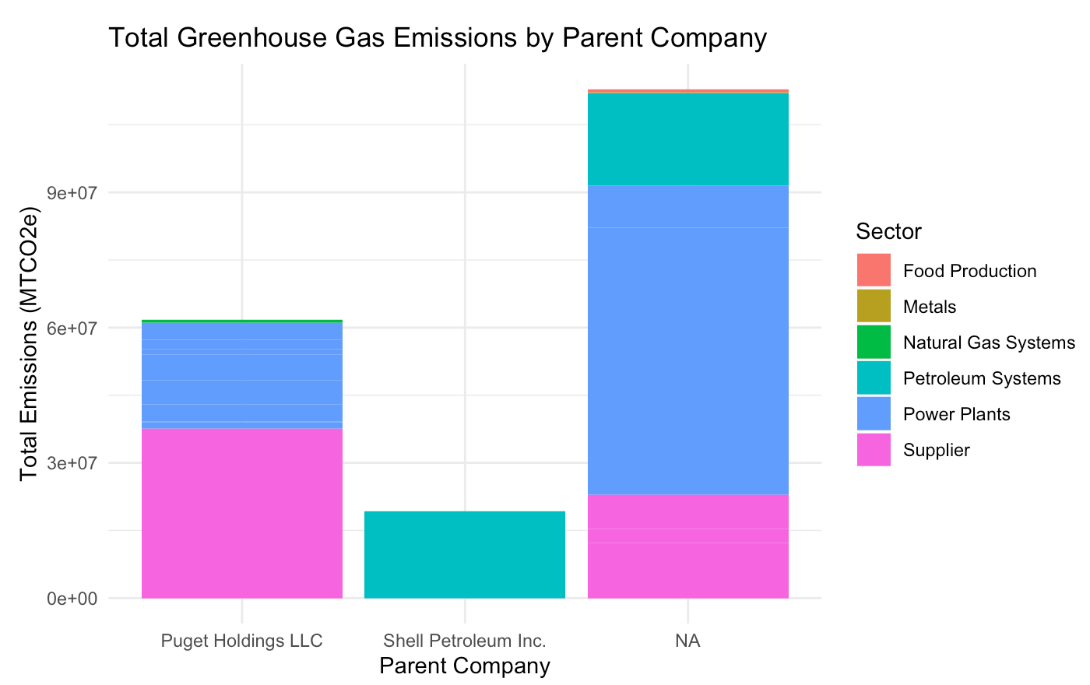
Total greenhouse gas emissions by parent company

Slide 8
Research Question 1: Data Analysis
The Sector that emits the most greenhouse gases is Power Plants
The City that emits the most greenhouse gases is Centralia
The Company that emits the most greenhouse gases is Puget Holdings
Interesting Observation: Centralia is the City that emits the most greenhouse gases and its all due to power plants which also happens to be the Sector that emits the most greenhouse gases.

Slide 9
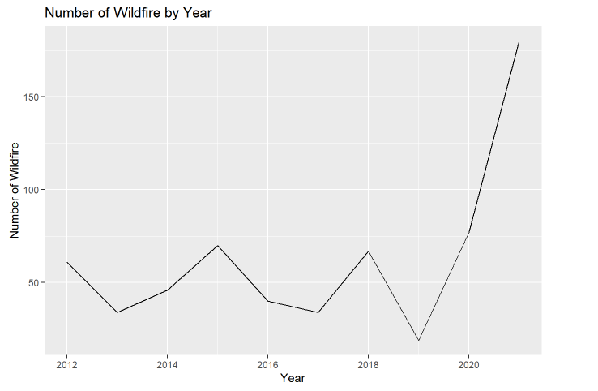
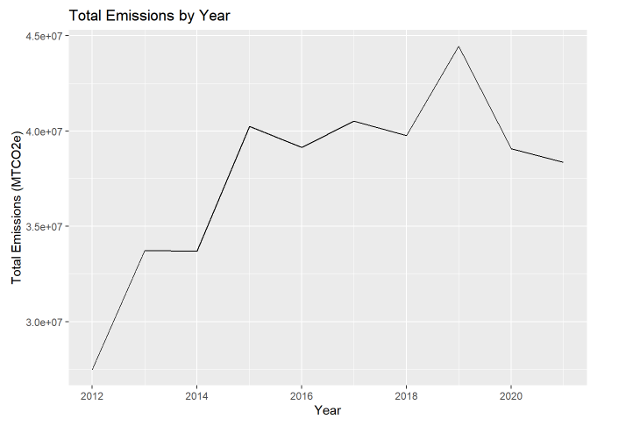
Research Question 2: Is there a correlation between greenhouse gas emissions and wildfire amounts and sizes in Washington State?
Number of Wildfire by year & total greenhouse gas emissions by year.

Slide 10
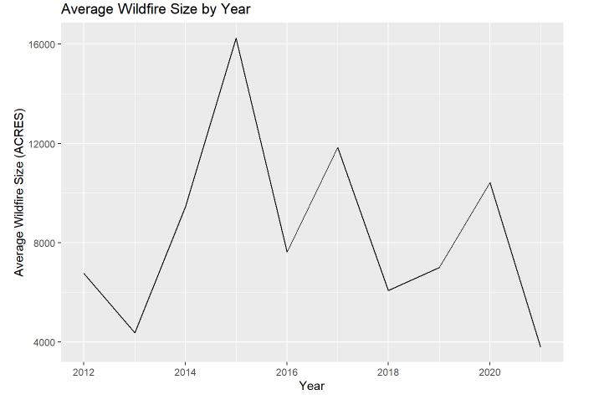
Size of wildfire by year & Total greenhouse gas emissions by year.

Slide 11
Research Question 2: Data Analysis
While the number of wildfires is rapidly increasing from 2019, the total gas emissions has decreased from 2019.
The rise in significant wildfires coincided with an increase in total gas emissions.
Analyzing the graph above, the correlation between wildfire size and total gas emissions appears to follow a cause-and-effect pattern, whereas the correlation between the number of wildfires and total gas emissions appears to exhibit an opposite trend.

Slide 12
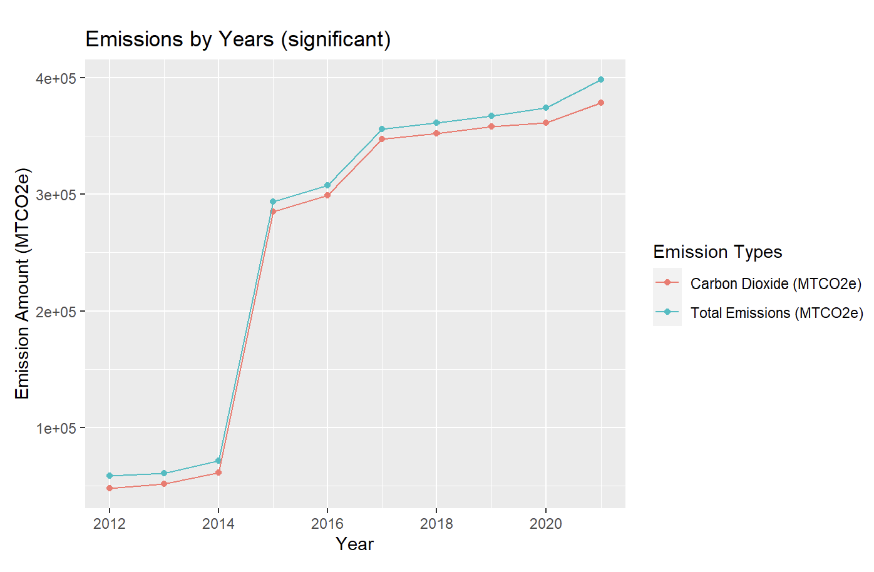
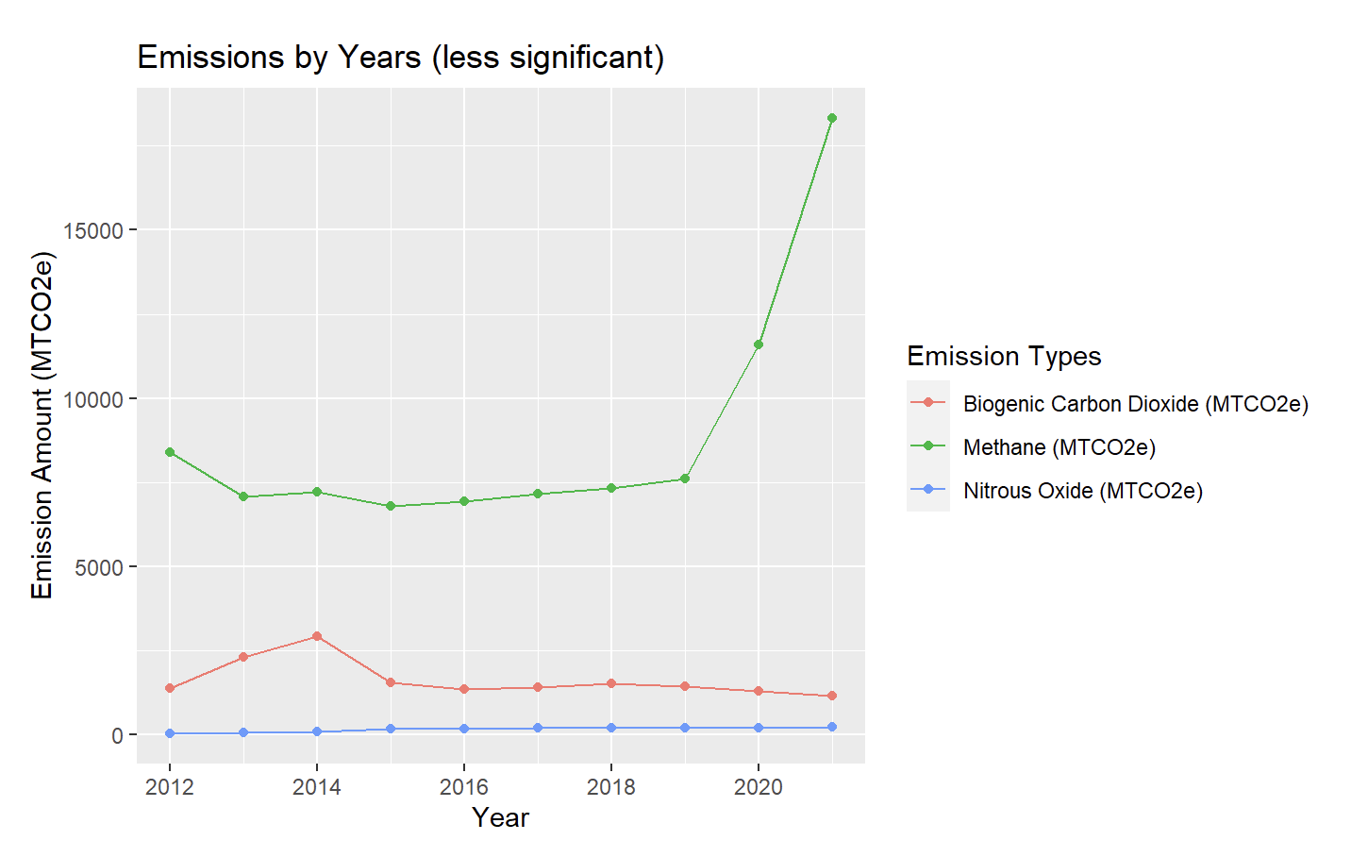
Research Question 3: Is there a correlation between GHG emissions and air pollution?
GHG Emissions, King County based to match Air pollution data

Slide 13
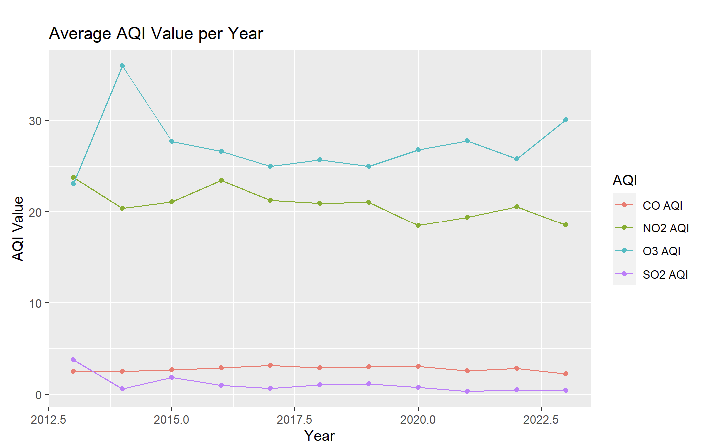
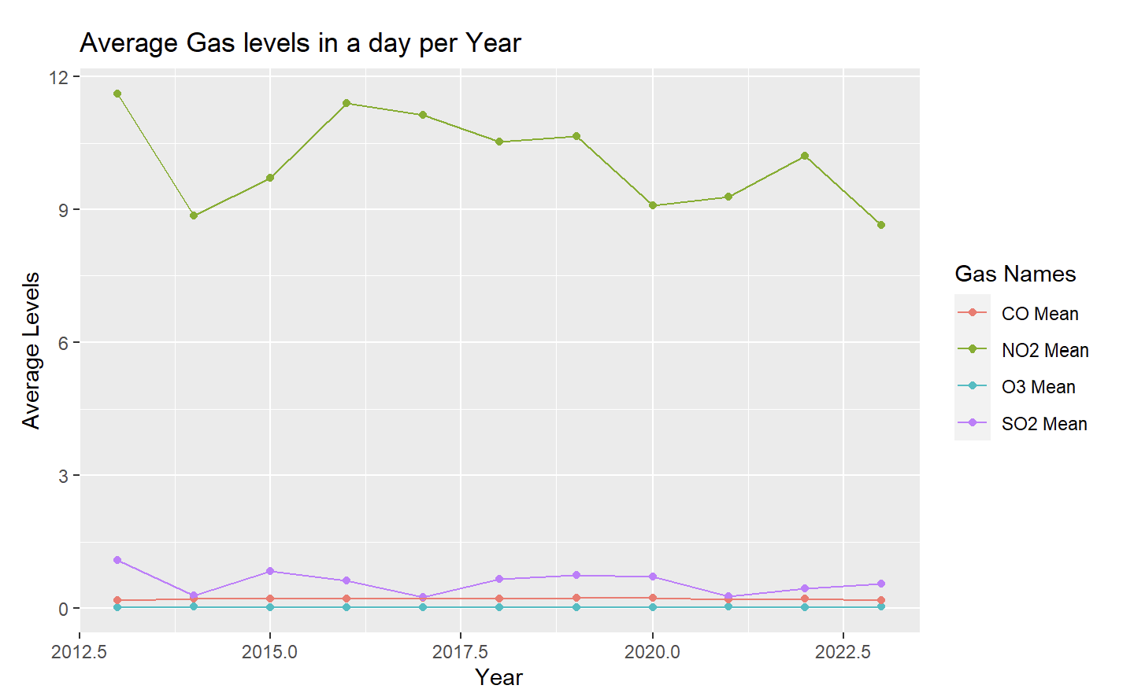
Air Pollution and AQI data

Slide 14
Research Question 3: Data Analysis
Increasing trend in Average GHG Emissions per Year
AQI and Average Gas levels in a day per year look stagnate (some fluctuations but within the same error)
No notable difference between the air in Seattle as the GHG emissions increase
Maybe due to time lags in GHG emissions impacting the atmosphere

Slide 15


Slide 16
Concluding Remarks
Found areas to prioritize in sectors, location, and companies within Washington (highest total emissions)
We see an increase in number of wildfires a year in cohesion with an increase in total emissions
But our air quality seems unaffected at the moment and should remain this way for some time based on the patterns
Next steps: Policymakers, scientists, and Washington people should be focused on reducing emissions from power plants (convert partly to renewable) which we predict would reduce the number of wildfires according to our correlated data.

